Slide 1

The hot Hand fallacy
A cognitive social bias

Slide 2
Definition, origin and affects
Definition: The "hot hand" is a cognitive social bias, in which a person who experiences a successful outcome has a greater chance of success in further attempts.
Origin: The "hot hand" was first described in a 1985 paper by Thomas Gilovich, Amos Tversky, and Robert Vallone. The "Hot Hand in Basketball" study questioned the hypothesis that basketball players have "hot hands", which the paper defined as the claim that players are more likely to make a successful shot if their previous shot was successful.
Affects:
It has affect mostly in sports activities when people believe that player more likely to make a successful shot if the previous shot was successful. Therefore these people may change their behavior according to this belief. For example: a basketball player that shot successfully will be more likely to get the ball again from his teammates to take advantage of the "hot hand".
Also, it affect gamblers that believe they will win more money after they won. As a result he might lose more money down hill.

Slide 3
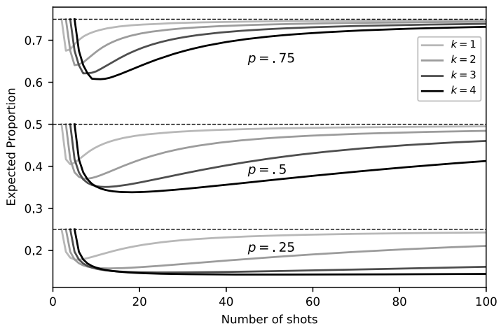
Example of influence of "hot hand" bias
Based on the paper: "Surprised by the Gambler's and Hot Hand Fallacies? A Truth in the Law of Small Numbers"
https://papers.ssrn.com/sol3/papers.cfm?abstract_id=2627354
In the figure we can see the expected proportion of successes that follow k consecutive successes, as a function of the total number of trials, for different values of p=probability of success

Slide 4
Affect on data collection from people
We should be aware of the "hot hand" bias when collecting data from people for research.
For example, if our research is checking in what position on the basketball court a player is more likely to receive the ball, we will have to take into consideration that a player will tend to throw the ball to the player with the "hot hand" (the player that had successful shots) regardless of their position on the court.

